Slide 1




Critical Thinking S1 2023
Tutor: Dr. Iwan Williams
Email: iwan.williams1@monash.edu

Slide 2
Lecture 3.1
Soundness and generalised form
Notes:
10 mins

Slide 3
Review quiz!

Slide 4
Where are we?
What is an argument?
An argument a set of claims where some of the claims (premises) are used as reasons to support another claim (the conclusion).
What makes an argument good/successful?
Support: If the premises were true, would they provide a good reason to accept the conclusion?
Truth: Are the premises true?

Slide 5
Where are we?
What is an argument?
An argument a set of claims where some of the claims (premises) are used as reasons to support another claim (the conclusion).
What makes an argument good/successful?
Support: If the premises were true, would they provide a good reason to accept the conclusion?
Truth: Are the premises true?
Deductive support (validity)
If the premises were true the conclusion must be true.
Inductive support
If the premises were true the conclusion would be very likely to be true.

Slide 6
Recap: Validity (deductive support)
An argument is deductively valid if and only if:
If the premises were true, then the conclusion would have to be true.
Another way to put it:
It is impossible for the conclusion to be false if the premises were true.
Notes:
This gives us a test for validity: if we can imagine a possible scenario in which the premises are all true but the conclusion is false, then the argument must be invalid. If we cannot imagine such a scenario, the argument is valid.

Slide 7
Recap: Validity (deductive support)
Key points:
Validity is about the connection between the premises and the conclusion.
It is not about the actual truth of the premises (or the conclusion).
So it’s possible for a valid argument to have false premises (or conclusion).
And it’s possible for an invalid argument to have true premises (and conclusion).

Slide 8
Deductive soundness
A sound argument is a valid argument with true premises.
Soundness = validity (deductive support) + true premises.
A sound argument is (by definition) valid, so…
If the premises are (or were) true, then the conclusion must be true.
But a sound argument also (by definition) has true premises, so…
The conclusion must be true!

Slide 9
Generalised form
Standard form
P1. If it is raining, then you will get wet.
P2. It is raining.
Therefore,
C. You will get wet.
Paragraph form
Needless to say, if it’s raining – you will get wet. And it’s raining outside right now, so you’re gonna get wet!

Slide 10
Generalised form – extracting the structure
Standard form
P1. If it is raining, then you will get wet.
P2. It is raining.
Therefore,
C. You will get wet.
Generalised form
If A then B
A
Therefore,
B
A = It is raining
B = You will get wet
Notes:
We replace certain parts of the statement with letters
What’s interesting is that a different argument can have the same form!
This is a form called modus ponens

Slide 11

All that should be left in your generalized form are variables (As, Bs, etc) and logical operators.

Slide 12
Logical operators
Logical operators systematically change the meaning of propositions typically by connecting two or more propositions together
if… then…
… and …
… or …
… if and only if …
All … are …
Some … are …
Not …
if it is raining then I will get wet
it is raining and I will get wet
it is raining or I will get wet
I will get wet if and only if it is raining
all pedestrians are wet
some pedestrians are wet
it is not raining

Slide 13
Why bother with generalized form?
Clearly separates validity from truth.
So we’re less likely to get tripped up by tricky cases.
Helps us to quickly identify common argument forms which we already know are valid or invalid.

Slide 14
Two cases of generalized form
We can use variables in generalized form in two different ways:
To represent claims (aka. statements/propositions)
To represent categories (aka. classes, kinds) of things

Slide 15
Generalised form
Paragraph form
Our company should either invest in cryptocurrency or in artificial intelligence. But we shouldn’t invest in cryptocurrency. So we should invest in AI instead.
Standard form
P1. Either our company should invest in cryptocurrency or our company should invest in artificial intelligence.
P2. Our company should not invest in cryptocurrency.
Therefore,
C. Our company should invest in artificial intelligence.
Generalized form
P1.
P2.
Therefore,
C.

Slide 16
Generalised form
Always include a key in your generalised form!
Paragraph form
Our company should either invest in cryptocurrency or in artificial intelligence. But we shouldn’t invest in cryptocurrency. So we should invest in AI instead.
Standard form
P1. Either our company should invest in cryptocurrency or our company should invest in artificial intelligence.
P2. Our company should not invest in cryptocurrency.
Therefore,
C. Our company should invest in artificial intelligence.
Generalized form
P1.
P2.
Therefore,
C.

Slide 17
Generalised form
Key:
A= Our company should invest in cryptocurrency.
B= Our company should invest in artificial intelligence.
Paragraph form
Our company should either invest in cryptocurrency or in artificial intelligence. But we shouldn’t invest in cryptocurrency. So we should invest in AI instead.
Standard form
P1. Either our company should invest in cryptocurrency or our company should invest in artificial intelligence.
P2. Our company should not invest in cryptocurrency.
Therefore,
C. Our company should invest in artificial intelligence.
Generalized form
P1. Either A or B
P2. Not A
Therefore,
C. B

Slide 18
Generalised form
Key:
A= Wooden things
B= Flammable things
x= this table
Paragraph form
All wooden things are flammable. This table is wooden. So this table is flammable.
Standard form
P1. All wooden things are flammable.
P2. This table is wooden.
Therefore,
C. This table is flammable.
Generalized form
P1. All A are B
P2. x is A
Therefore,
C. x is B
P1. All wooden things are flammable.

Slide 19
Lecture 3.2
Testing for validity
Notes:
15 mins

Slide 20
Testing for validity: Four methods
Can I imagine a scenario in which the premises are true and yet the conclusion is false?
Does the the generalised form allow me to construct a counter example?
Does the generalised form match a common valid or invalid argument form?
Can I use a Euler diagram to test for validity?

Slide 21
Testing for validity – counter examples
All things with engines need oil.
All cars need oil.
Therefore,
C: All cars have engines
All A are B.
All C are B.
Therefore,
All C are A.
A = things with engines
B = things that need oil
C = cars
A = plants
B = things that need water
C = animals

Slide 22
Testing for validity – Euler diagrams
C
?
“All A are B”
“All C are B”
B
All A are B.
All C are B.
Therefore,
All C are A.
All things with engines need oil.
All cars need oil.
Therefore,
C: All cars have engines
A
Conclusion is true!
Conclusion is false!

Slide 23
Testing for validity – Euler diagrams
G
P1. All Fs are Gs
P2. x is an F
Therefore,
C. x is a G
P1. All guitars are musical instruments (Gs)
P2. The object in my hands (x) is a guitar (F)
Therefore,
C. The object in my hands (x) is a musical instrument (G)
F
x
Valid!

Slide 24
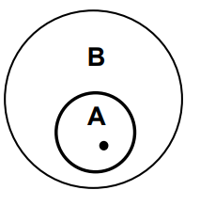
Modus ponens
If A, then B
A
Therefore,
B
P1. If today is Tuesday, then John will go to work.
P2. Today is Tuesday.
Therefore,
C. John will go to work.
Affirming the antecedent = valid

Slide 25
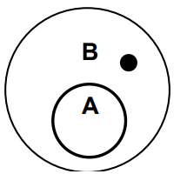
P1. If Bill Gates owns Fort Knox, then Bill Gates is rich.
P2. Bill Gates is rich.
Therefore,
C. Bill Gates owns Fort Knox.
If A, then B
B
Therefore,
A
Affirming the consequent = invalid!

Slide 26
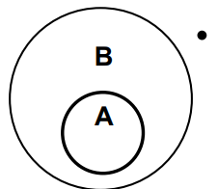
Modus tollens
If A, then B
Not B
Therefore,
Not A
P1. If you have a current password, then you can log on to the network.
P2. You cannot log on to the network.
Therefore,
C. You do not have a current password.
Denying the consequent = valid

Slide 27
If A, then B
Not A
Therefore,
Not B
P1. If you are a ski instructor, then you have a job.
P2. You are not a ski instructor.
Therefore,
C. You have no job.
Denying the antecedent = invalid!

Slide 28
Summary
Affirming the antecedent (modus ponens) = valid
Affirming the consequent = invalid
Denying the consequent (modus tollens) = valid
Denying the antecedent = invalid

Slide 29
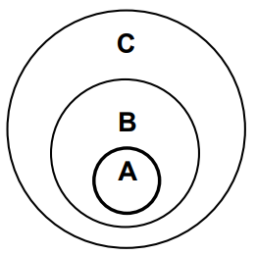
Hypothetical syllogism
If A, then B
If B, then C
Therefore,
If A, then C
P1. If I go to campus, then I’ll get a coffee.
P2. If I get a coffee, then I’ll be hyperactive.
Therefore,
C. If I go to campus, I’ll be hyperactive.
Valid!

Slide 30
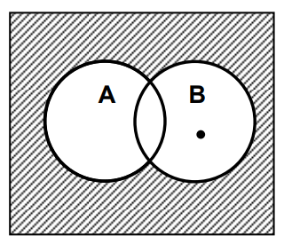
Disjunctive syllogism
Either A or B
Not A
Therefore,
B
P1. Either Iwan has had a coffee or he is tired.
P2. Iwan hasn’t had a coffee.
Therefore,
C. Iwan is tired.
Valid!

Slide 31
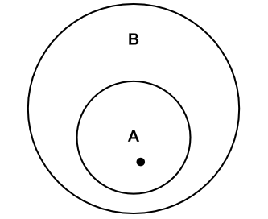
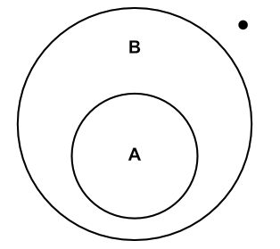
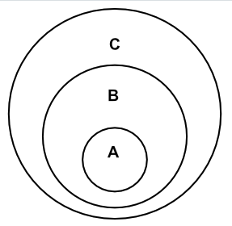
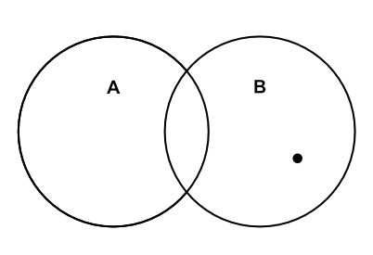
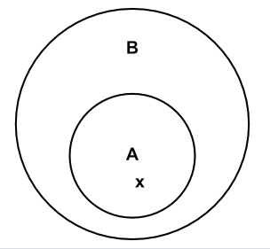
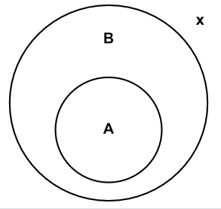
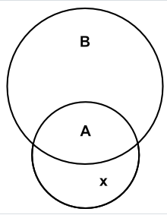
Argument form name | Argument form | Euler Diagram
Modus ponens | If A then B A Therefore: B
Modus tollens | If A then B not B Therefore: not A
Hypothetical syllogism | If A then B If B then C Therefore: If A then C
Disjunctive syllogism | Either A or B not A Therefore: B
Universal modus ponens | All A are B x is A Therefore: x is B
Universal modus tollens | All A are B x is not B Therefore: x is not A
Counter-example | Some A are not B Therefore: Not all A are B

Slide 32
Two invalid forms
Argument form name | Argument form
Denying the antecedent | If A, then B Not A Therefore, Not B
Affirming the consequent | If A, then B B Therefore, A

Slide 33
Lecture 2.3
Conditional statements
Notes:
5 mins

Slide 34
Conditional statements

Slide 35
Conditional statements
A statement with an “if… then…” structure
e.g. “if it is raining then you will get wet”
The statement following the “if” is called the
Antecedent
The statement following the “then” is called the
Consequent

Slide 36




Conditional statements
Don’t confuse conditional statements with arguments.
If there’s a fire in the building then we should leave immediately.
There’s a fire in the building, so we should leave immediately.
P1. There’s a fire in the building.
Therefore,
C. We should leave immediately.
Conditional statement
Argument

Slide 37
Conditional statements
“If A then B” isn’t the same as “if B then A”
“If it’s raining then it’s cloudy” (T)
”If it’s cloudy then it’s raining” (F)

